Slide 1
TECHNEX’26 IIT BHU
Team Name : NEXT GEN DEVELOPERS
Team Members : ARYAN MISHRA , ADITYA KUMAR SINGH
TECHNEX I’D : TX265071 , TX265062
Category : SOFTWARE
Problem Statement : INTERACTIVE CLIMATE DATA VISUALIZATION AND INTELLIGENCE

Slide 2
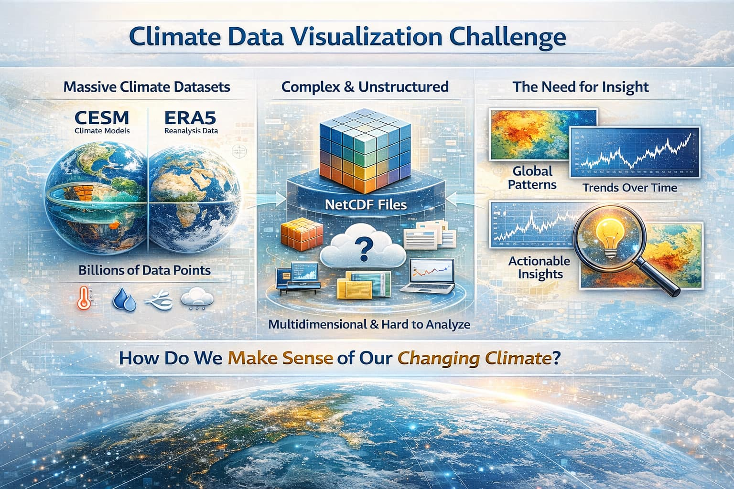
Next Gen Developers
Billions of Climate Data Points — Where Are the Insights?
Climate datasets like CESM and ERA5 contain billions of multidimensional data points.
These datasets are stored in NetCDF format, which is complex and difficult to analyze quickly.
Traditional tools are not interactive enough to explore global climate changes effectively.
There is a need for a fast, interactive platform to visualize climate data and extract insights.
Climate datasets are extremely large (TB–PB scale), making quick analysis difficult.
Lack of intuitive visualization makes it difficult to communicate climate insights to the public

Slide 3
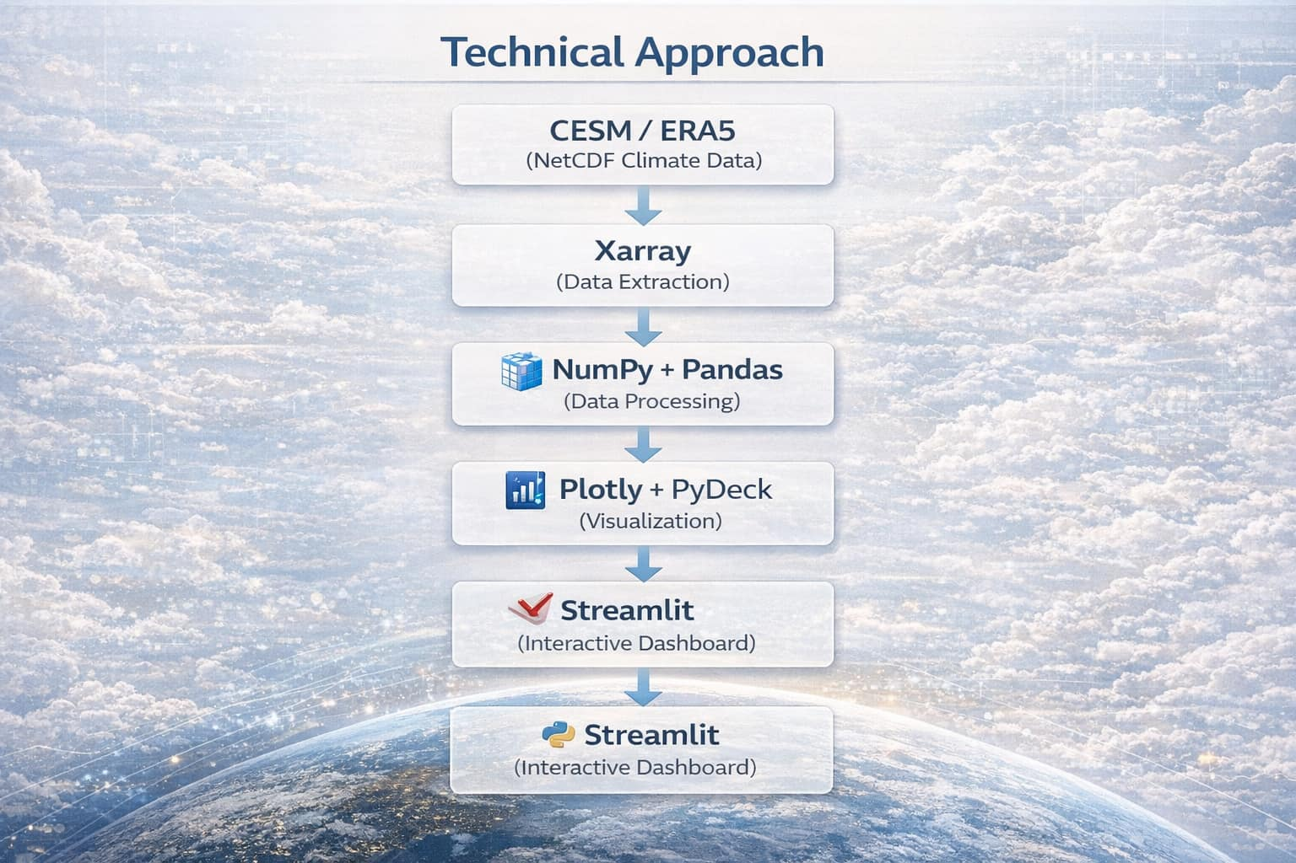
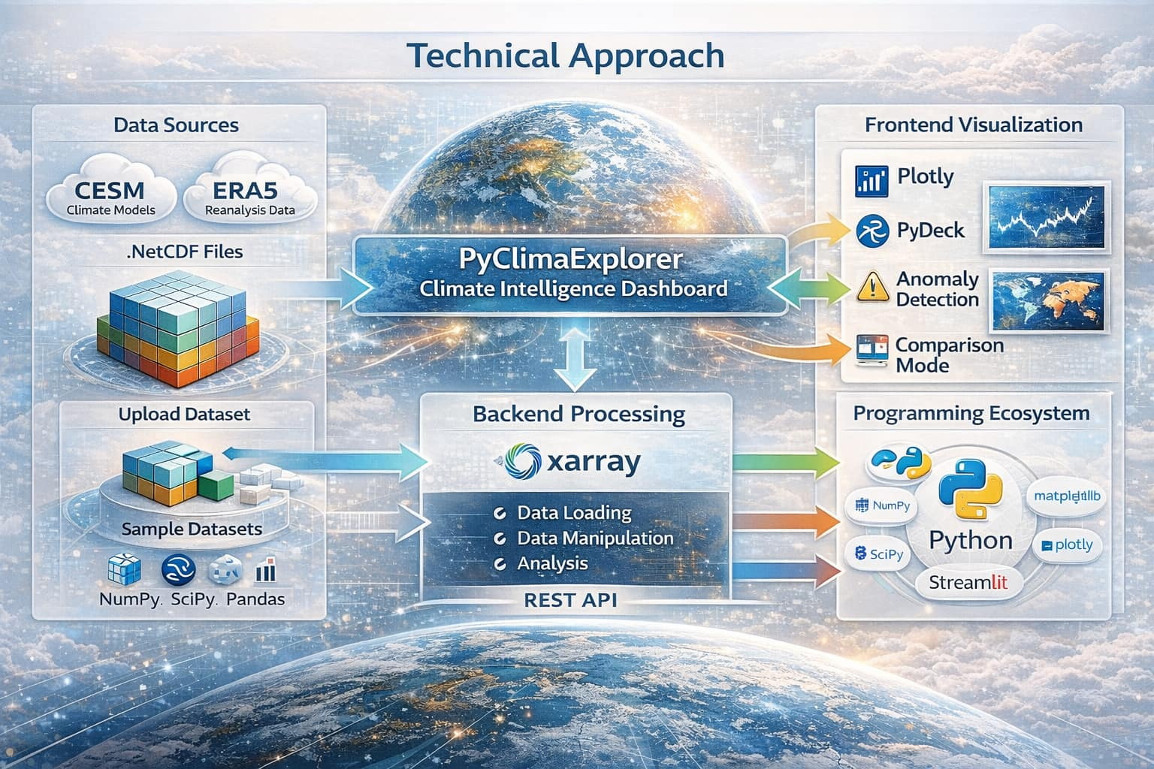

TECHNICAL APPROACH
Next Gen
Developers
Climate Data Sources: Use global climate datasets such as CESM climate models and ERA5 reanalysis data stored in NetCDF format.
Interactive Dashboard: Deploy the system as a user-friendly web interface using Streamlit for real-time exploration of climate data.

Slide 4
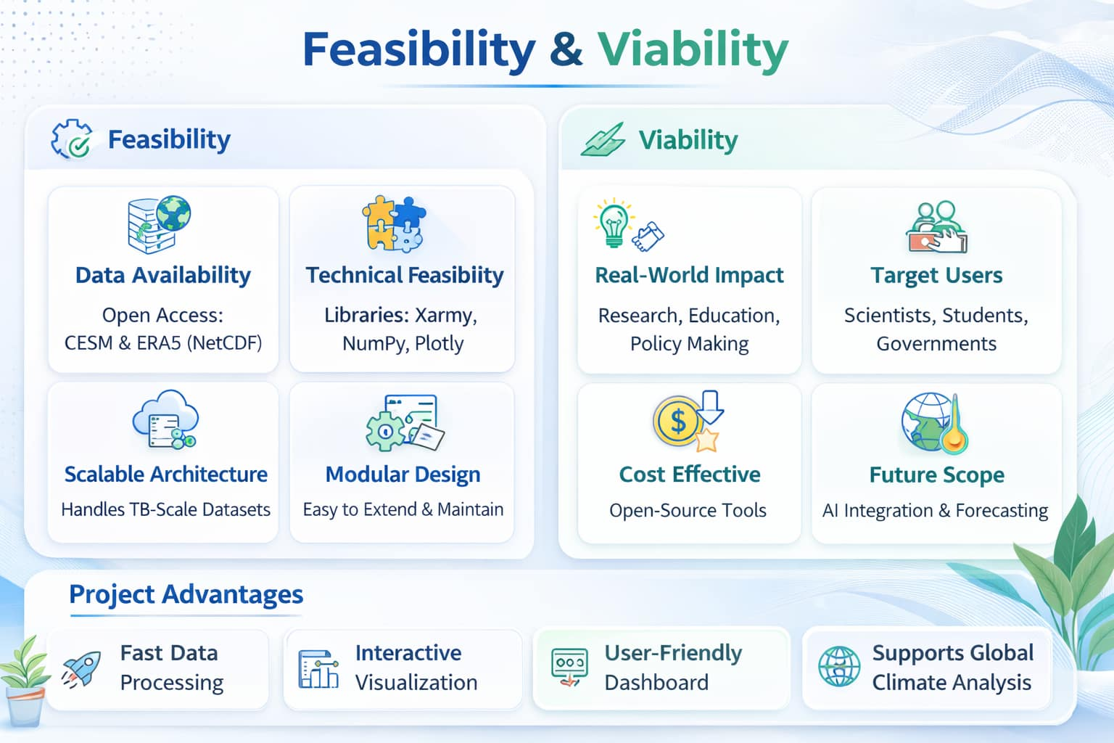






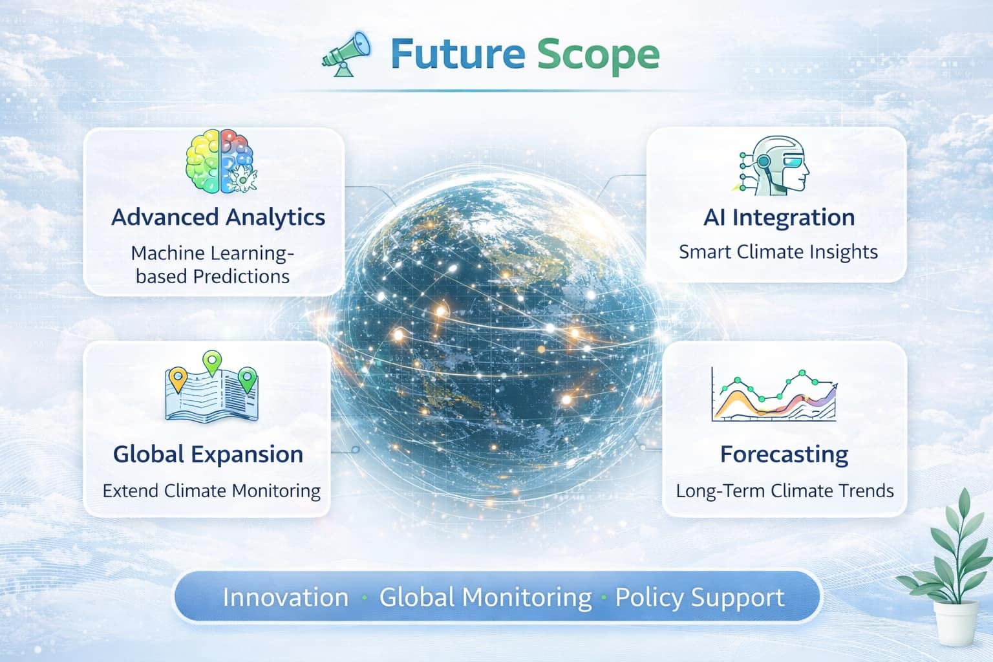



FEASIBILITY AND VIABILITY
Next Gen Developers
Feasibility
Open Climate Datasets Available: Public datasets like CESM and ERA5 provide reliable NetCDF climate data for analysis.
Existing Python Ecosystem: Powerful libraries such as Xarray, NumPy, Plotly, and Streamlit .
viability Economic
Cost-Effective Development: Built using open-source tools (Python, Xarray, Plotly, Streamlit) which reduces development and deployment costs.
Scalable and Sustainable: The platform can be scaled for research institutions, universities, and climate organizations
User Experience: Simple and intuitive interactive dashboard design.
Scalability: Ability to handle larger datasets and future features.
Visualization Clarity: Clear maps, graphs, and insights for easy understanding
Key Consideration

Slide 5


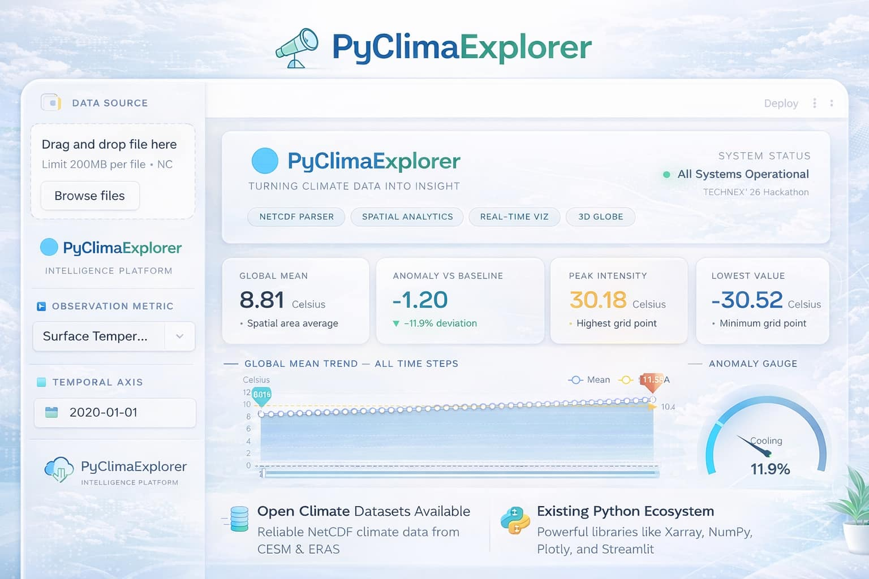
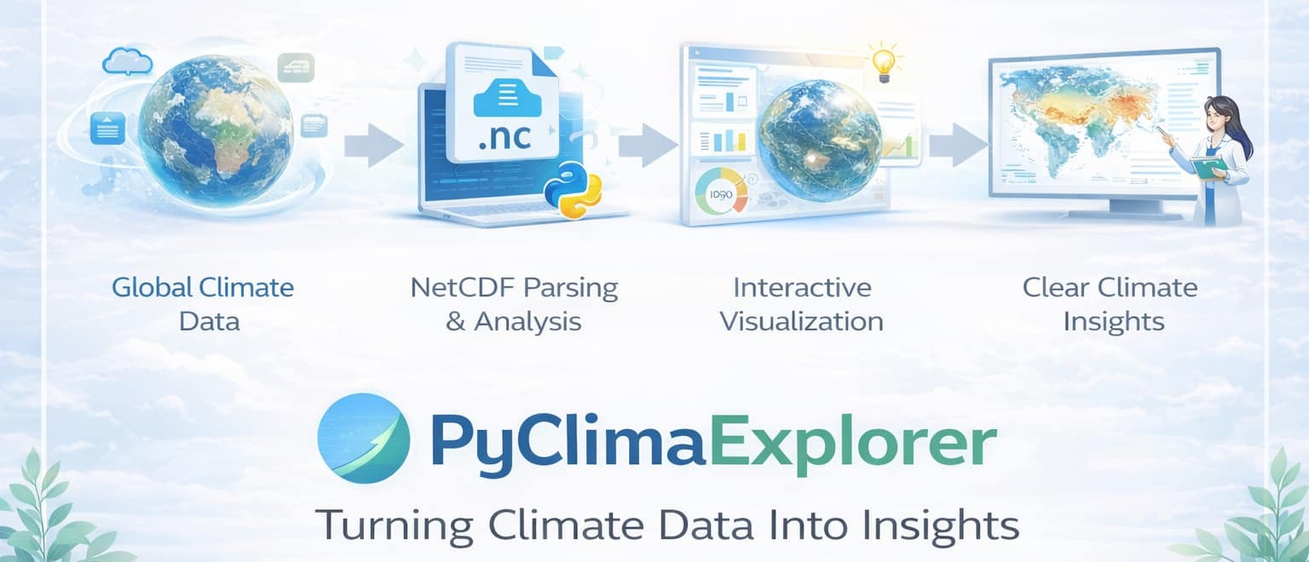
PyClimaExplorer From Climate Data to Climate Insights
Next Gen Developers
Interactive Climate Data Visualization: Converts complex NetCDF climate datasets into intuitive maps and charts.
Spatial Climate Mapping: Displays global distribution of climate variables using interactive heatmaps.
AI-Based Climate Prediction: Uses machine learning models to analyze historical data and forecast future climate trends.
PyClimaExplorer integrates data visualization and anomaly detection.
PyClimaExplorer End to End Workflow
5

Slide 6




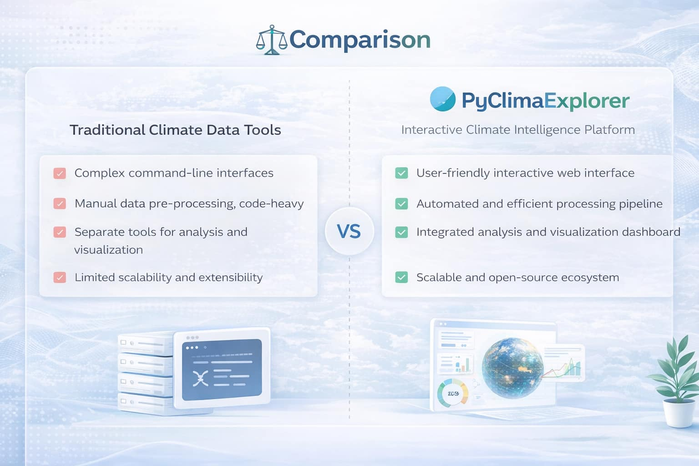

RESEARCH AND REFERENCES
Next Gen Developers
Comparison Between OtherTools and PyClimaExplorer
Reference
CESM Climate Model Dataset – National Center for Atmospheric Research Earth System Model Data
NetCDF Climate Data Format – Unidata Program Center Documentation
Python Climate Data Libraries – Xarray, Plotly, Streamlit
Understanding Climate Through Visualization
Climate Intelligence Platform
6

Slide 7
THANK YOU

